Slide 1


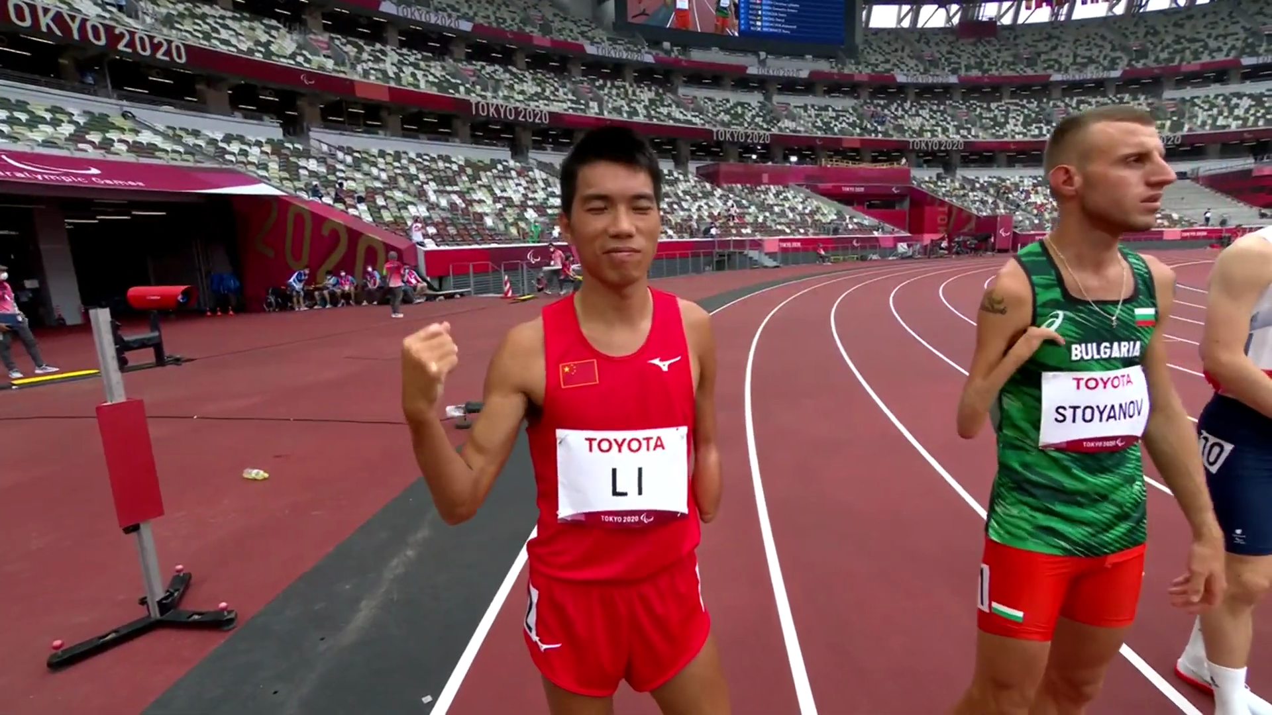
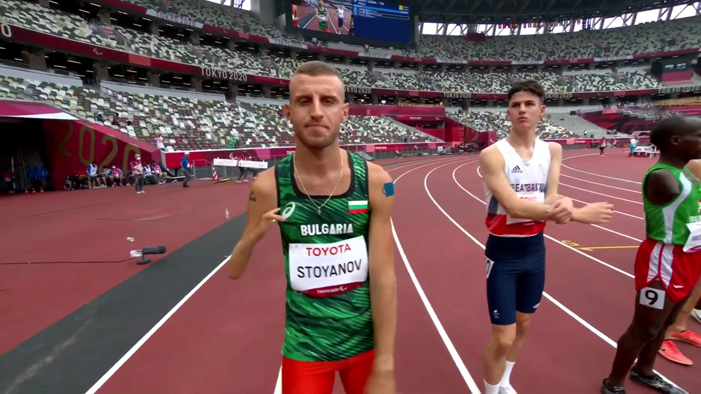

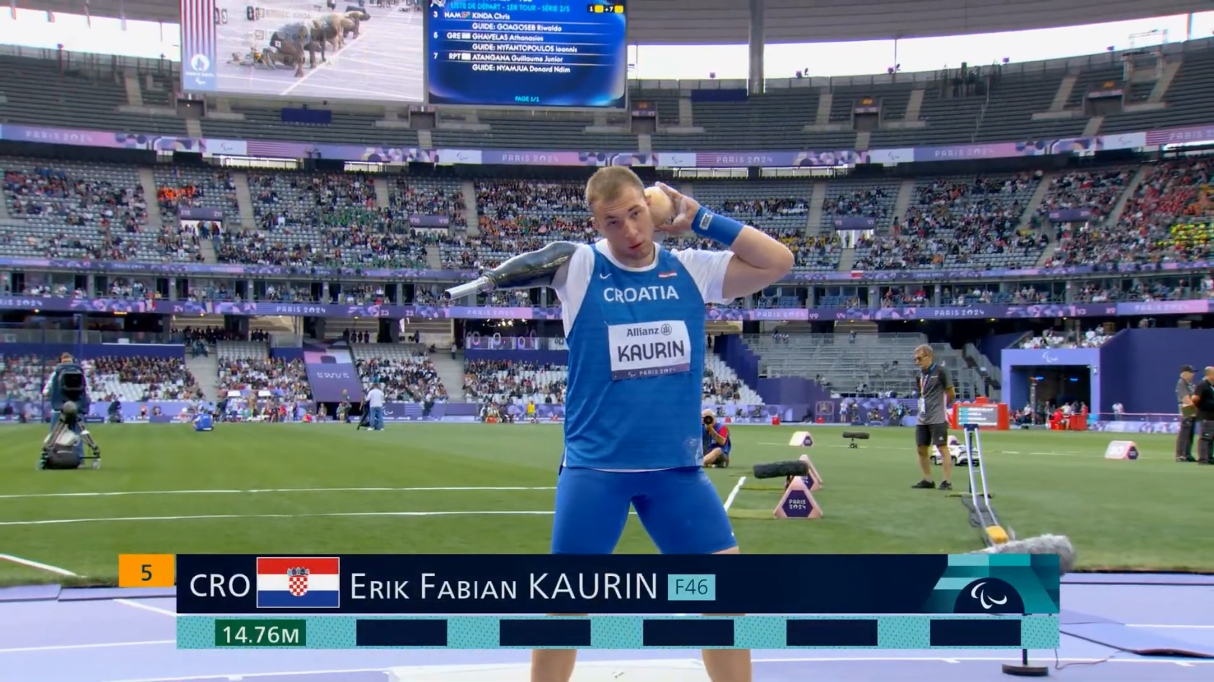
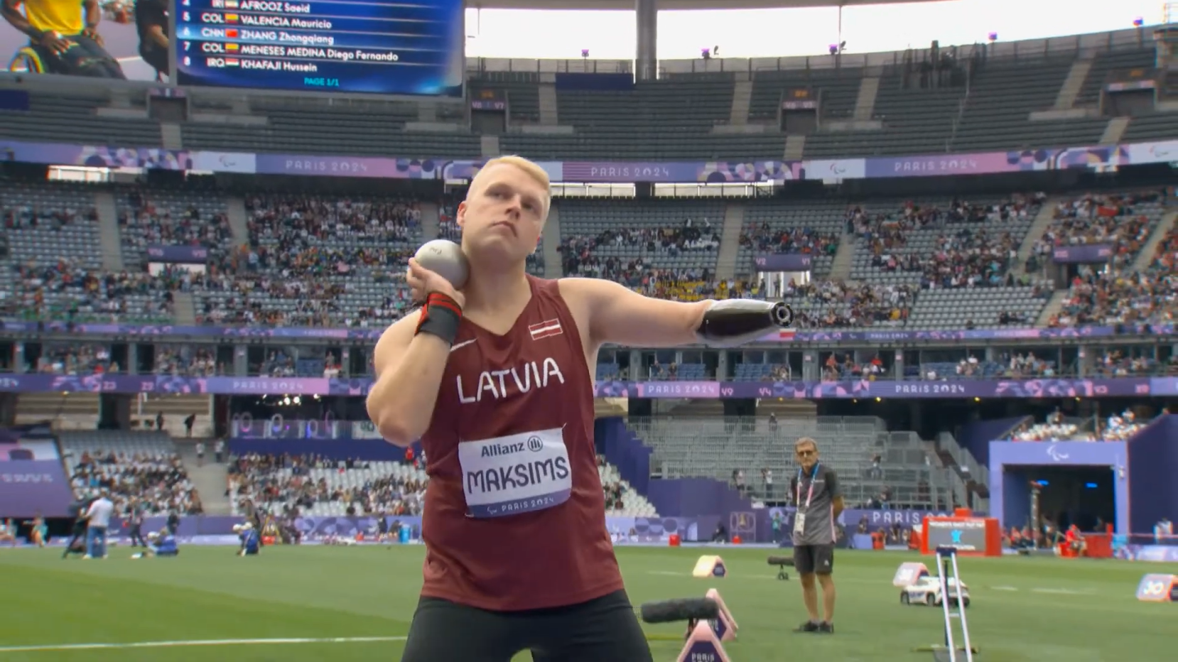
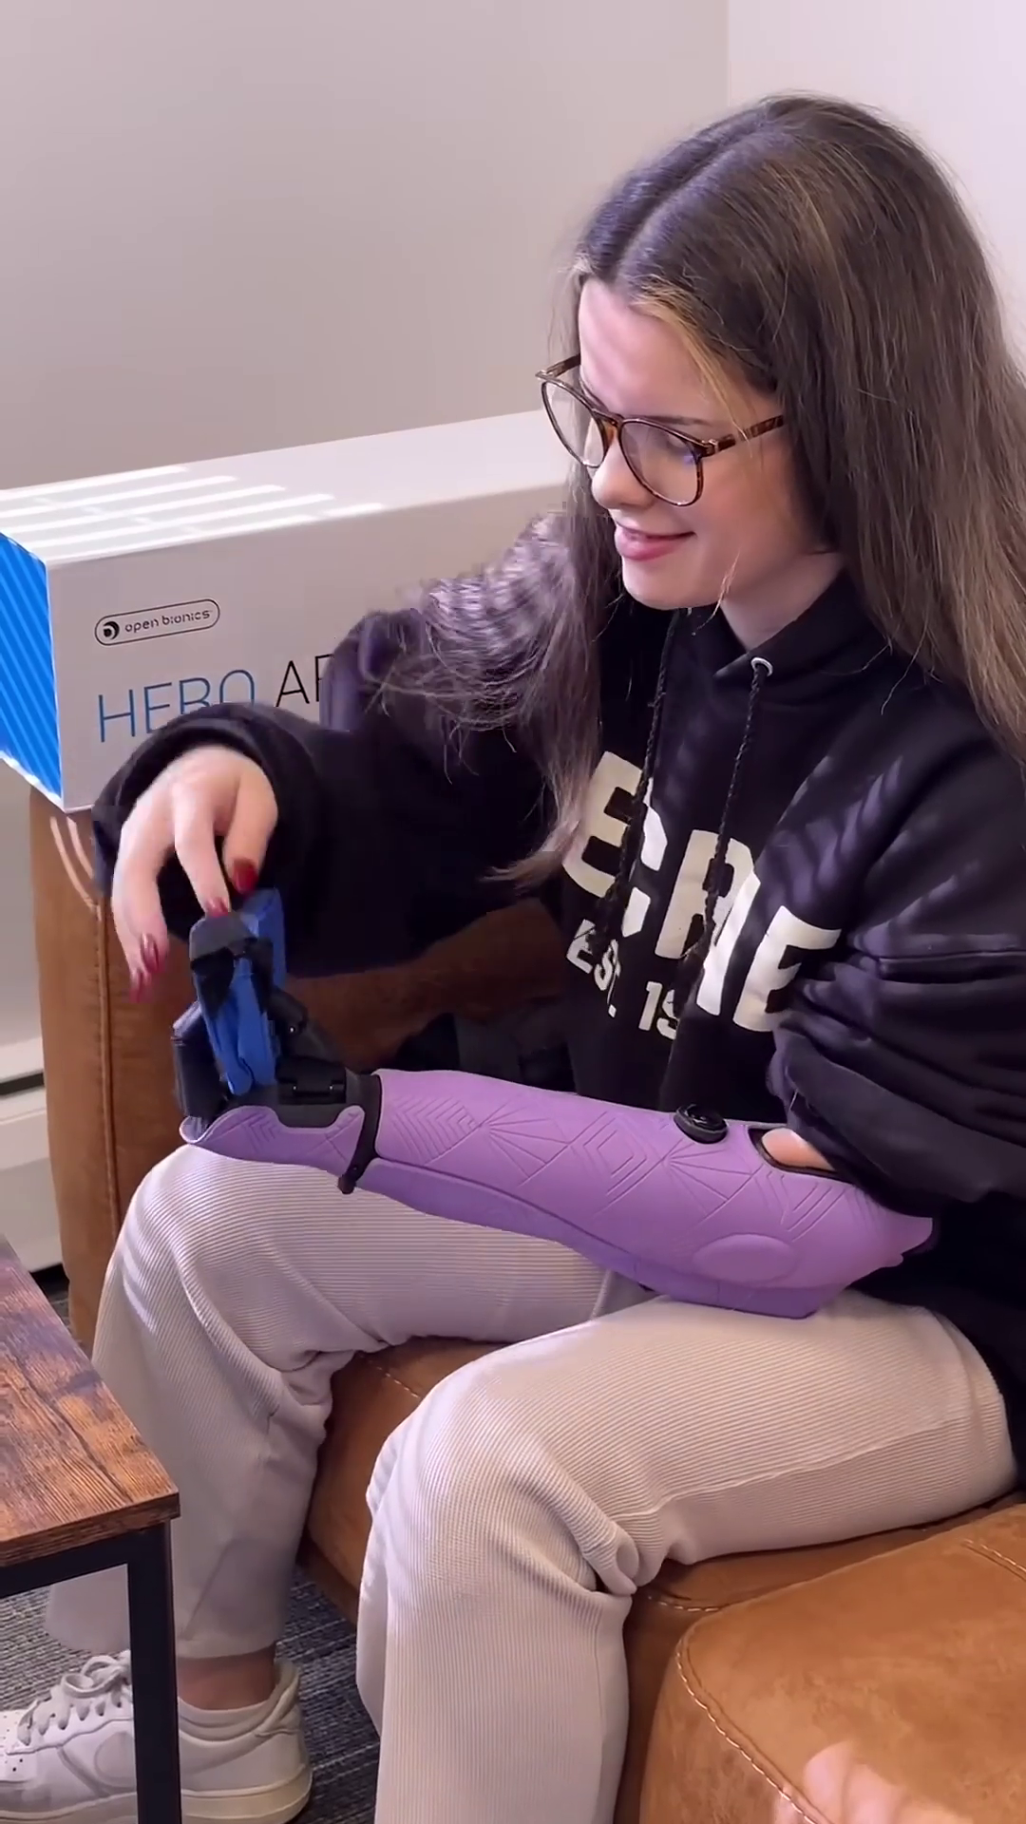
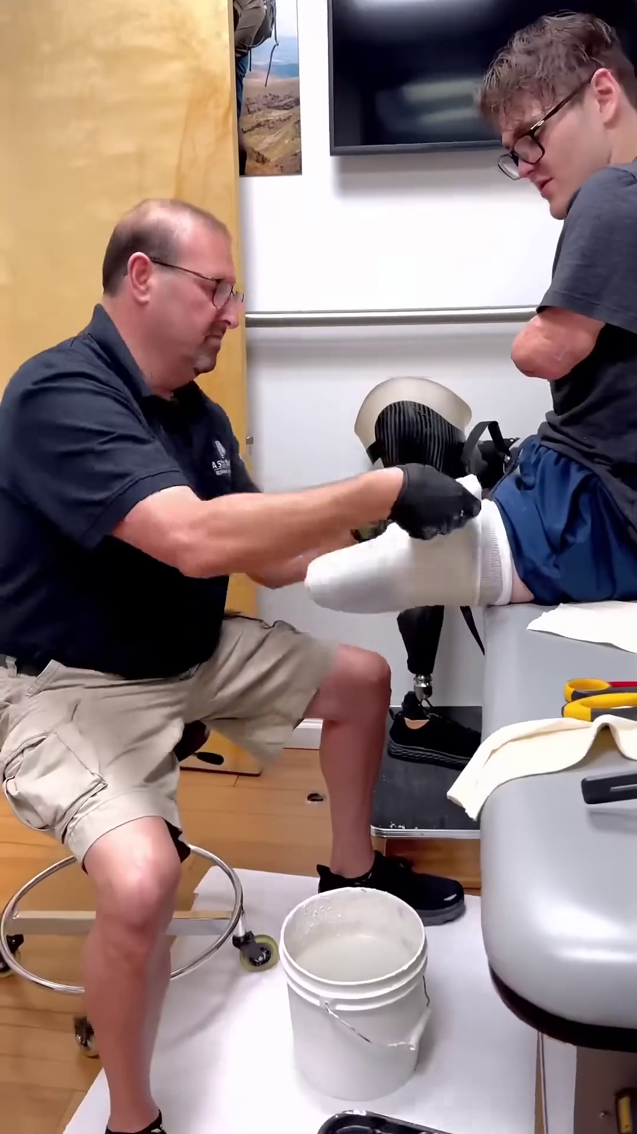
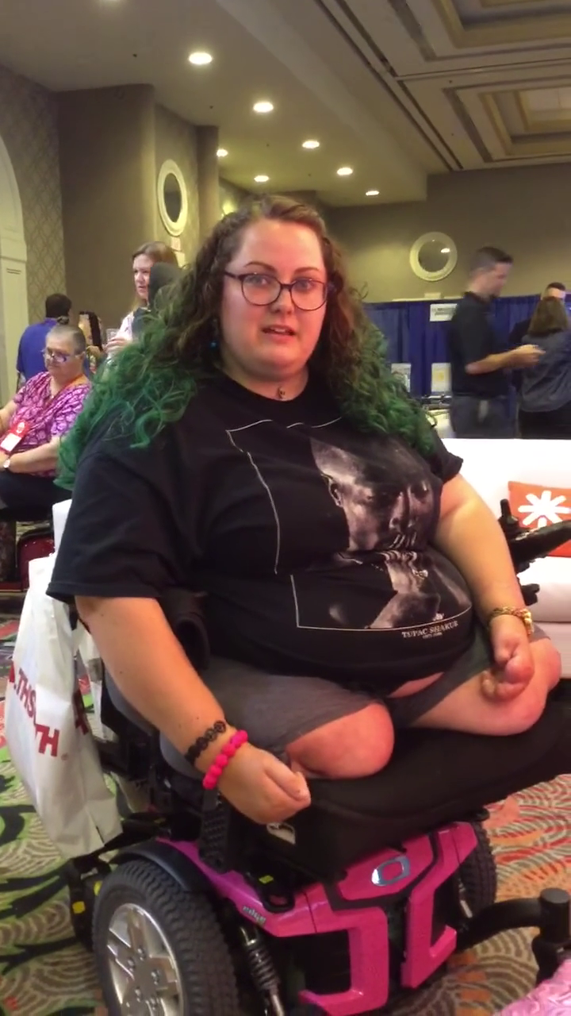
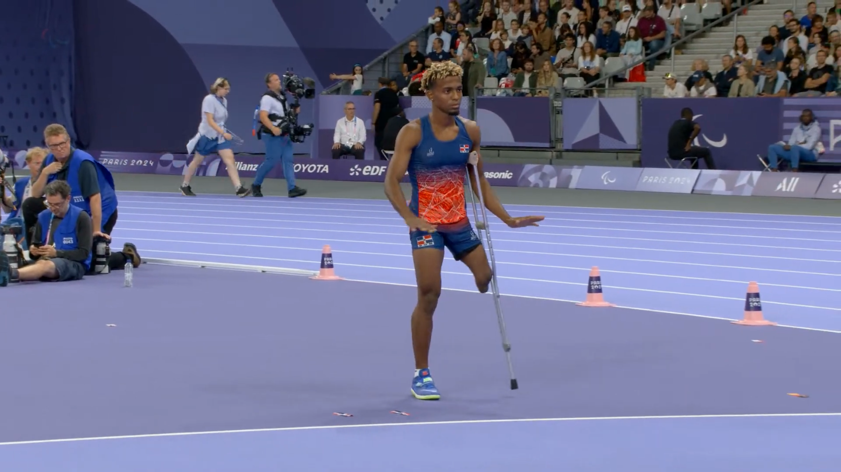
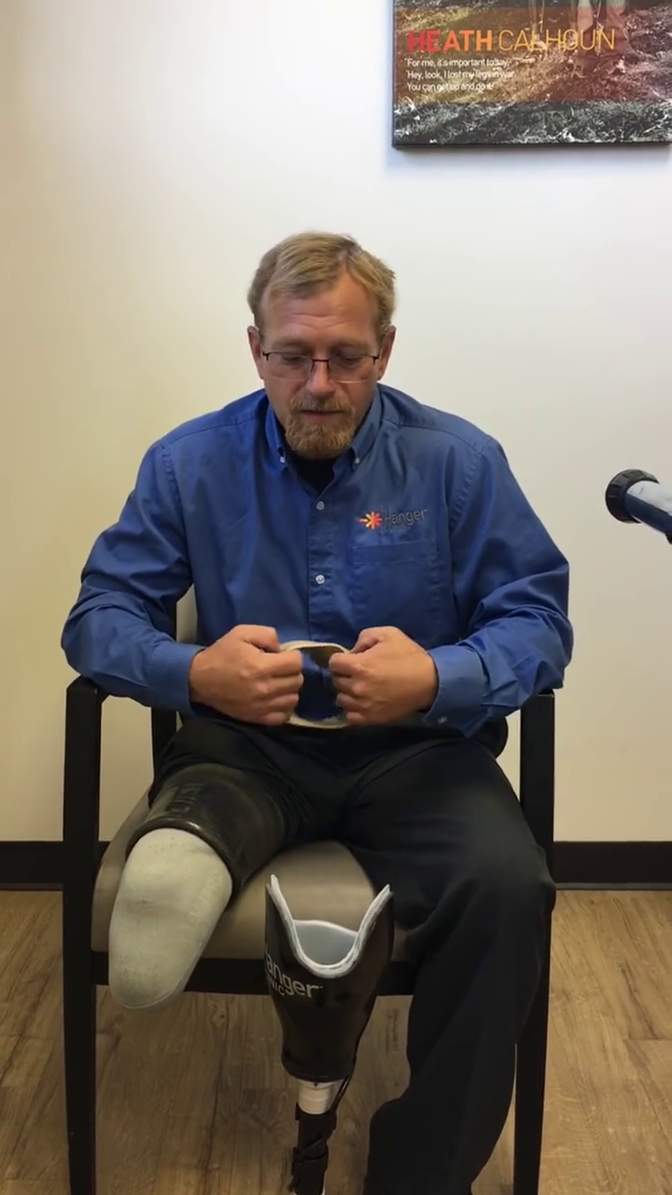
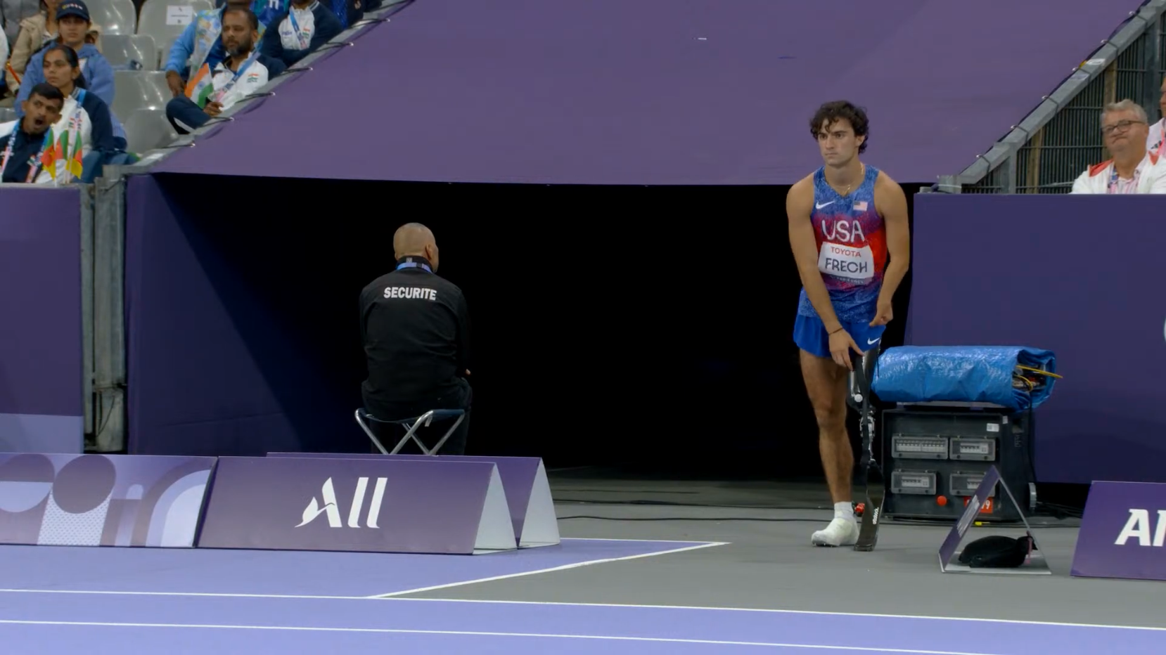
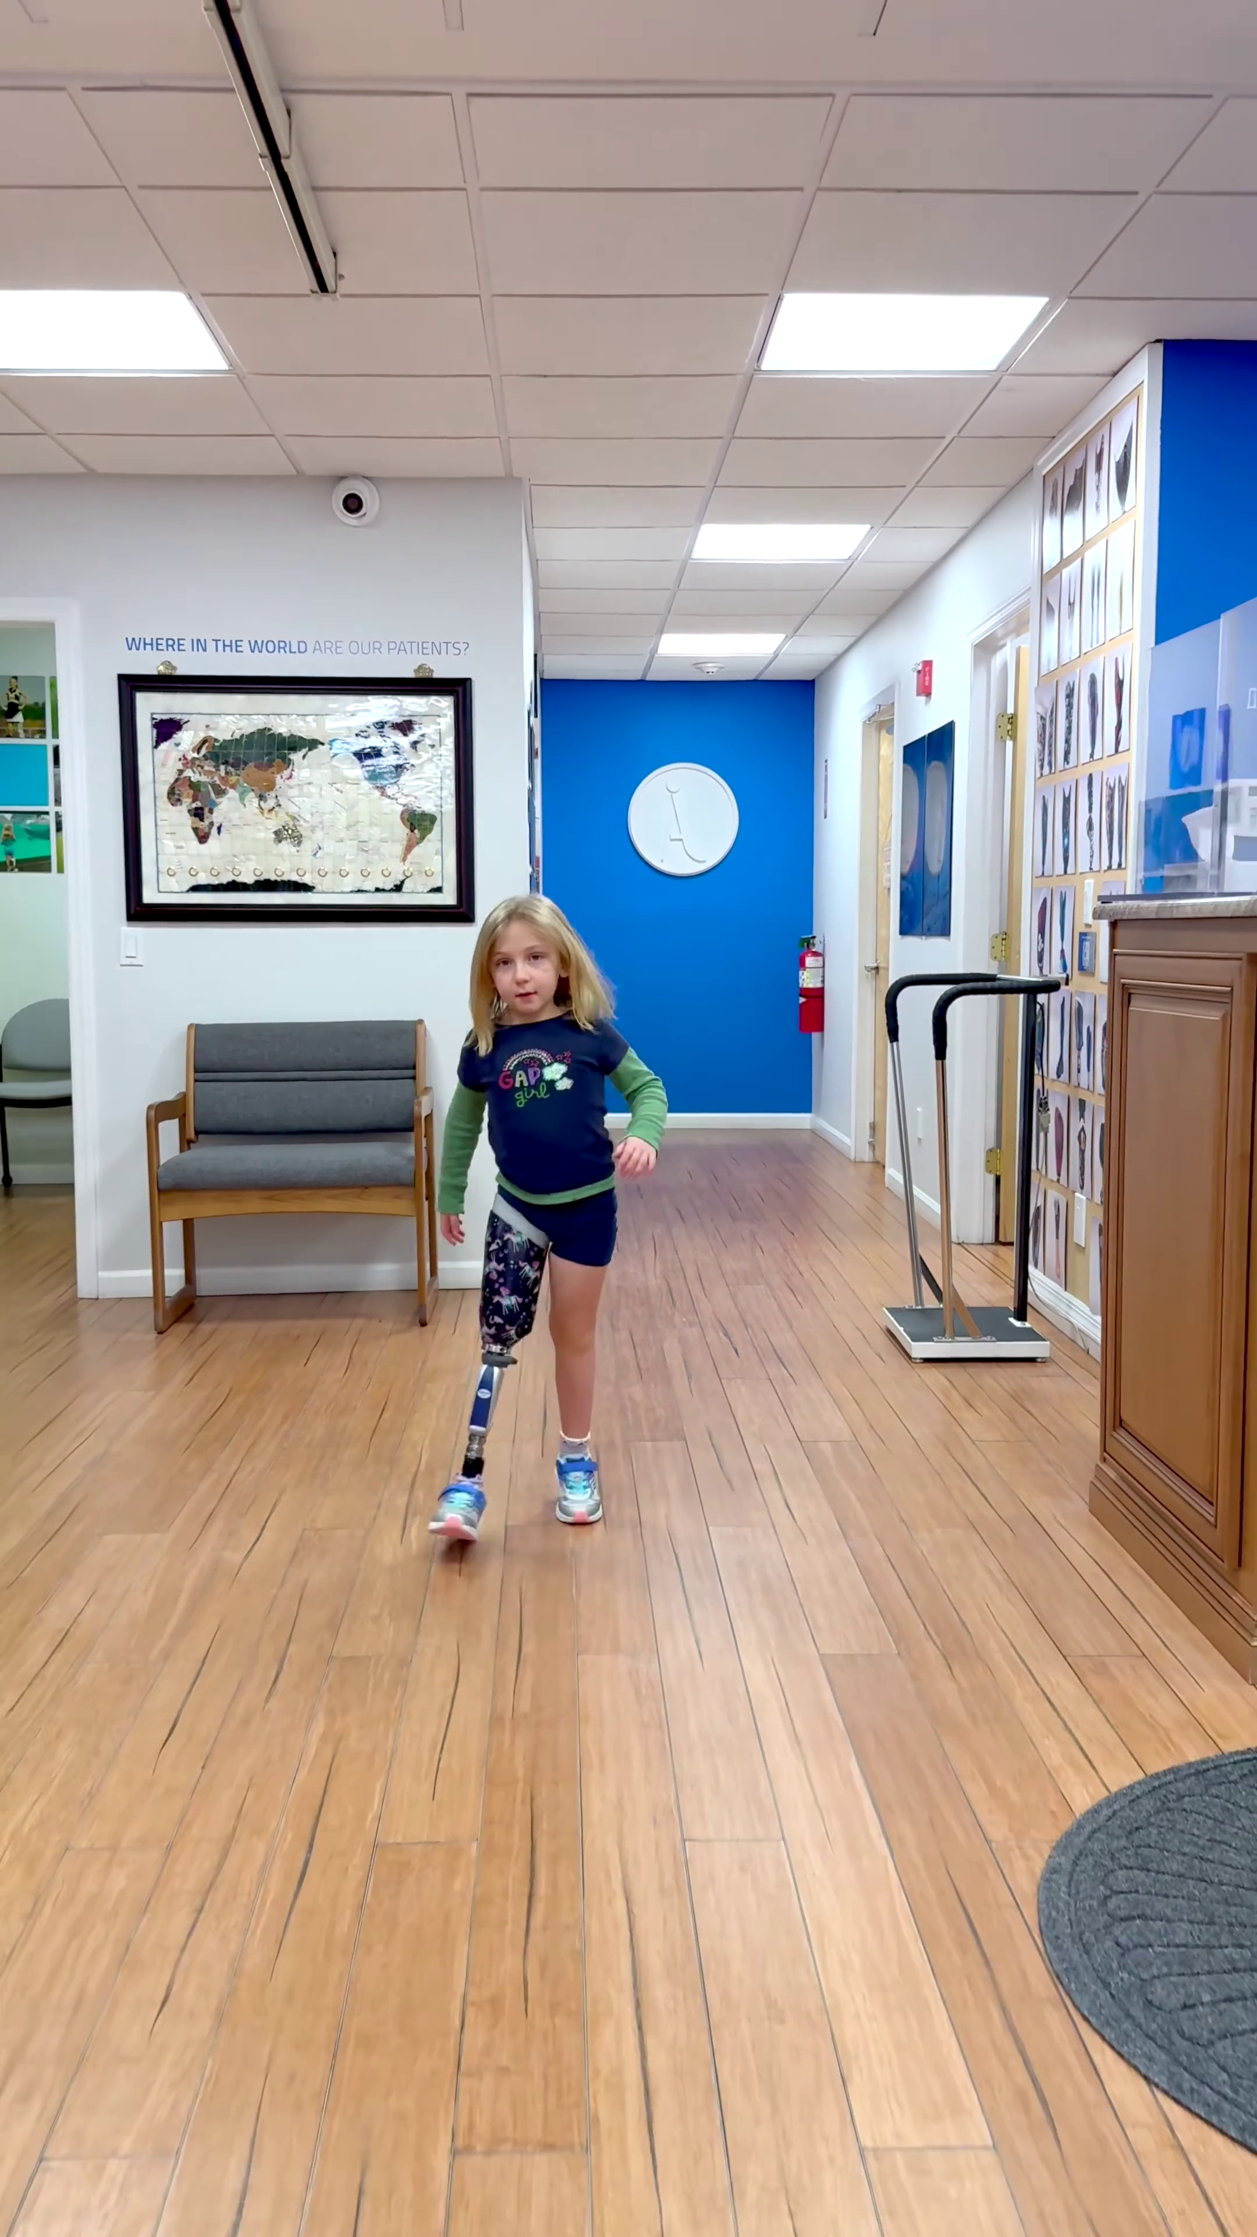
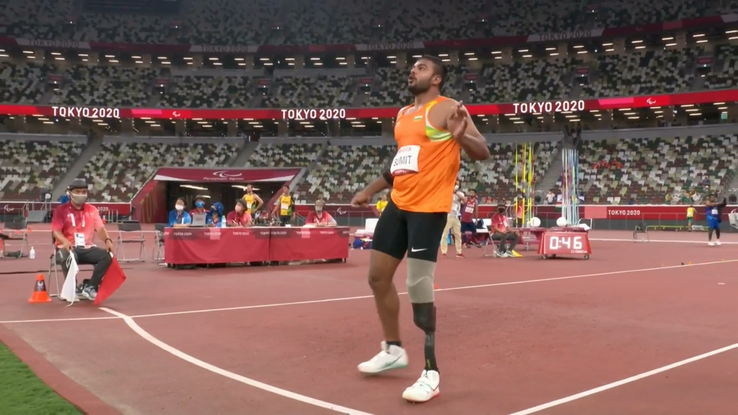
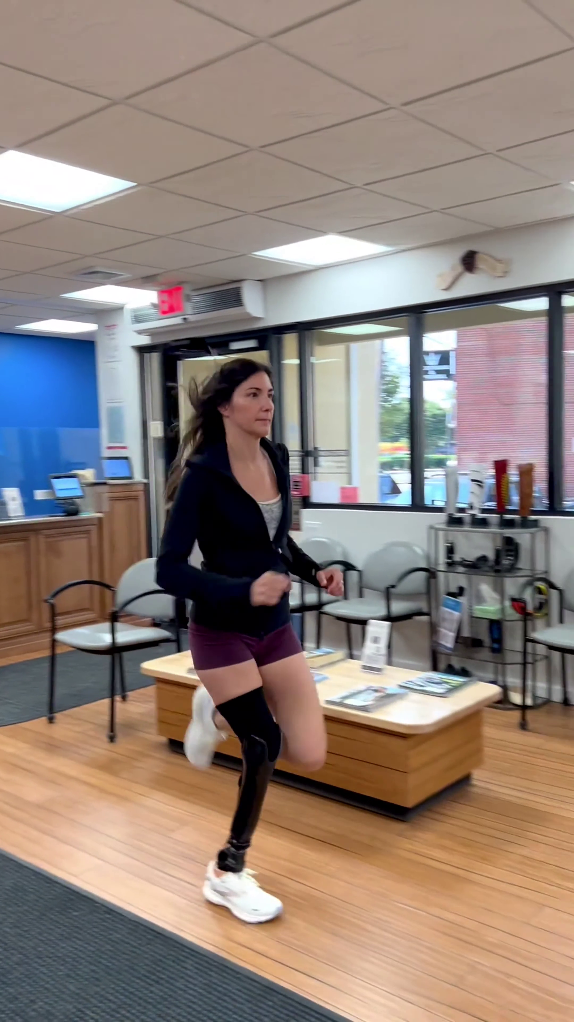
17: Above Left Elbow
Residual Limb End
18: Above Right Elbow
Residual Limb End
19: Below Left Elbow
Residual Limb End
20: Below Right Elbow
Residual Limb End
2
1
3
Residual Limb
4
0
6
5
17
18
Prosthesis
7
19
20
8
9
21: Above Left Knee
Residual Limb End
22: Above Right Knee
Residual Limb End
23: Below Left Knee
Residual Limb End
24: Below Right Knee
Residual Limb End
12
11
10
21
22
Residual Limb
14
13
23
24
16
15
Prosthesis

